Slide 1
Object-Oriented Program (CS F213)

Slide 2
Agenda
Inheritance
Polymorphism

Slide 3

Inheritance
It allows the creation of hierarchical classifications. Inheritance represents the IS-A relationship which is also known as a parent-child relationship (for example, Apple is a Fruit, Car is a Vehicle)
Using inheritance, you can create a general class that defines traits common to a set of related items. This class can then be inherited by other, more specific classes, each adding those things that are unique to it.
When you inherit from an existing class, you can reuse methods and fields of the parent class. Moreover, you can add new methods and fields in your current class also.
In the terminology of Java, a class that is inherited is called a superclass. The class that does the inheriting is called a subclass.
A subclass is a specialized version of a superclass. It inherits all of the members defined by the superclass and adds its own, unique elements
← Syntax of inheriting a superclass

Slide 4
Why Inheritance?
For method overriding (so runtime polymorphism can be achieved).
For Code Reusability.

Slide 5
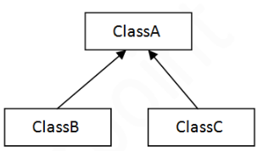
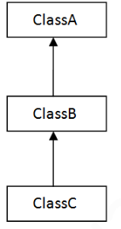
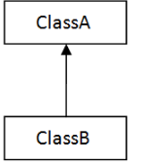
Types of Inheritance supported by java
Hierarchical
Single
Multilevel
Note: Please note that Java does not support multiple inheritance with classes. In java, we can achieve multiple inheritance only through Interfaces.

Slide 6
Example of Single inheritance
class Animal{
void eat(){
System.out.println(“eating…”);
}
class Dog extends Animal{
void bark(){
System.out.println(“barking…”);
}
}
class TestInheritance {
public static void main(String args[]){
Dog d=new Dog();
d.bark();
d.eat();
}
}
Ouput:
barking…
eating…

Slide 7
Member Access and Inheritance
Although a subclass includes all of the members of its superclass, it cannot access the members of the superclass that have been declared as private.

Slide 8
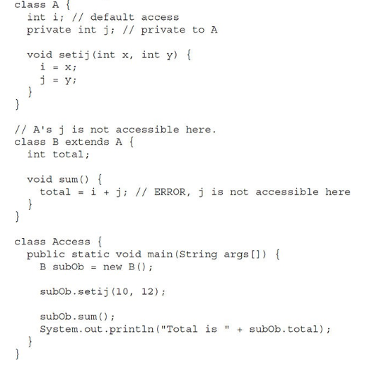
Note: Subclass has no access to private members of superclass.

Slide 9
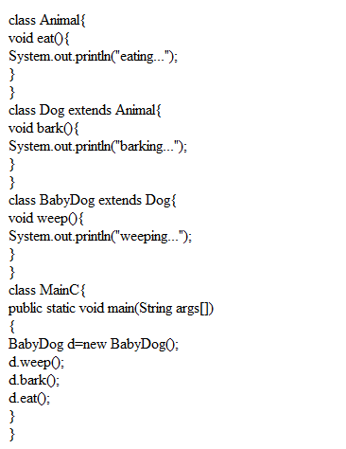
Example of Multilevel Inheritance
Output:
weeping…
barking…
eating…

Slide 10
Role of super keyword
In general, the constructor of subclass explicitly initializes the variables of superclass. Here, initialization of superclass variables is done twice in general, once in superclass and again by subclass. This repetition of code be avoided by super keyword in subclass.
Use case:
There will be times when you will want to create a superclass that keeps the details of its implementation to itself (that is, that keeps its data members private).
Whenever a subclass needs to refer to its immediate superclass, it can do so by use of the keyword super.

Slide 11
super in two forms
To Call Superclass Constructors:
A subclass can call a constructor defined by its superclass by use of the following form of super:
super(arg-list);
Here, arg-list specifies any arguments needed by the constructor in the superclass. super( ) must always be the first statement executed inside a subclass’ constructor.
2. The second form of super acts somewhat like this keyword, except that super always refers to the superclass of the subclass in which it is used.
This usage has the following general form:
super.member
Here, member can be either a method or an instance variable.
Note: The second form of super is most applicable to situations in which member names of a subclass hide members by the same name in the superclass.

Slide 12
One Example program (usage of super)
Output

Slide 13
Method overriding
When a method in a subclass has the same name and type signature as a method in its superclass, then the method in the subclass is said to override the method in the superclass.
When an overridden method is called from within its subclass, it will always refer to the version of that method defined by the subclass.
The version of the method defined by the superclass will be hidden.
Note : A static method cannot be overridden.

Slide 14
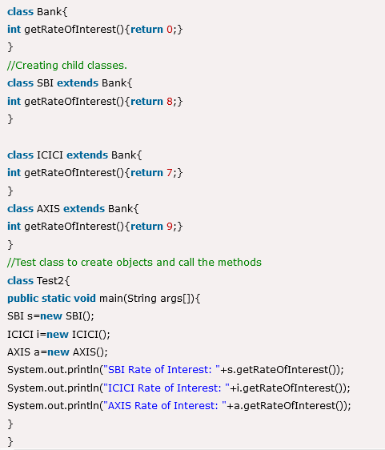
Real world example of Method Overriding

Slide 15
Why Overridden Methods?
Overridden methods allow Java to support run-time polymorphism.
Method overriding allows a general class to specify methods that will be common to all of its derivatives, while allowing subclasses to define the specific implementation of some or all of those methods.

Slide 16
Polymorphism
The word “polymorphism” means having many forms.
The word “poly” means many and “morphs” means forms, So it means many forms.
It can be defined as a task that can perform a single action in different ways.
In Java polymorphism is mainly divided into two types:
Compile time Polymorphism (static polymorphism or static binding). Method overloading is an example of compile time polymorphism.
Runtime Polymorphism (Dynamic Method Dispatch or Dynamic binding)

Slide 17
A Superclass Variable Can Reference a Subclass Object
A reference variable of a superclass can be assigned a reference to any subclass
derived from that superclass.
In this context, it is important to understand that it is the type of the reference variable—not the type of the object that it refers to that determines what members can be accessed.
In simple words: If there are some methods present in the superclass, but overridden (same methods) by a subclass and assume that an object of subclass is created, and we assign that object to the superclass reference variable, then we can use the superclass reference variable to execute the overridden method defined in the subclass.

Slide 18
Dynamic Method Dispatch
← An Example program of Dynamic Method Disptach (Runtime Polymorphism)
Important Points
When an overridden method is called through a superclass reference, Java determines which version of that method to execute based upon the type of the object being referred to at the time the call occurs.
Note: How does compiler knows which method to call?. Dynamic method dispatch, which is the mechanism by which a call to an overridden method is resolved at run time, rather than compile time.

Slide 19
Using final with Inheritance
Three uses of final keyword:
final can be used to create the equivalent of a named constant, i.e., its value can’t be modified. For example, final int a=2;
- final variables must be used only for the values that we want to remain constant throughout the execution of program.
2. final can be used to Prevent method Overriding.
3. final can be used to Prevent Inheritance

